Slide 1

WiCR
Building your self confidence
Rachel Gillett
2nd June 2021

Slide 2

Aims
The aim of the session is to enable you to build your self confidence and be able to put this into practice in your life

Slide 3
Learning outcomes
By the end of the session, you will be able to:
1
Explain what is meant by self confidence
List the skills, attitudes and behaviours that you already use when confident
Identify a range of tools and techniques and be able to use them appropriately
Describe 4 different ways of behaving and how these may affect the way you come across to people
Demonstrate self-confidence techniques in your life
Have an action plan to confidently achieve a goal in your life

Slide 4
Outline of the day
10am Welcome, introductions and housekeeping
What do we mean by self-confidence?
How confident are you?
Ways of behaving
Tools and techniques to develop your confidence
Putting it into practice
12.30 pm Lunch
1pm A solutions focussed approach
Action planning
Evaluation
2pm Close

Slide 5
Introductions
In small groups, 4 questions – 2mins each questions
Your name and something about yourself
Something you bring to the day
What do you understand by the term “self confidence”?
A situation you would like to deal with confidently

Slide 6
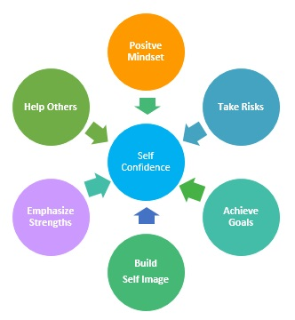
What is self confidence?

Slide 7
Being confident
I feel confident when…..
I don’t feel confident when….

Slide 8

What skills, attitudes and behaviours have you already got?

Slide 9
Types of Behaviour
Aggressive
Passive
Passive aggressive
Assertive

Slide 10
Being assertive
Assertive body language
Voice
Speech
Body posture
Movements
Eye contact

Slide 11
Techniques to help you
Basic assertion
Probing
Agreement
Negative feelings
Broken record
Empathetic
Responsive

Slide 12
Four Life Positions
Assertive: I’m ok, You’re ok
Aggressive: I ’m ok, You’re not ok
Passive Aggressive: I’m not ok, You’re not ok
Passive: I’m not ok, You’re ok

Slide 13
Building your toolkit
How can you do this?

Slide 14
Scripting
1. Explanation
2. Impact of the facts
3. Needs and wants/action
required
4. Consequences

Slide 15

Practice
  Tell your partner about the other person, what they are like and how they might respond.
  Practice dealing with the situation confidently
  Discuss how it went – what went well, what could be better?
  What is your next step?
  Swap over and repeat

Slide 16
A solutions based approach
Building on strengths:
desired state,
scaling,
identifying the positives,
the next small step,
getting there

Slide 17
Aims
The aim of the session is to enable you to build your self confidence and be able to put this into practice in your life

Slide 18
Learning outcomes
By the end of the session, you will be able to:
Explain what is meant by self confidence
List the skills and attitudes that you already use when confident
Identify a range of tools and techniques and be able to use them appropriately
Describe 4 different ways of behaving and how these may affect the way you come across to people
Demonstrate self-confidence techniques in your life
Have an action plan to confidently achieve a goal in your life

Slide 19

Thank you and ….

