Slide 1

Sally Ralston, Community Involvement Manager, Merseyrail
Event Management
29th June 2021

Slide 2
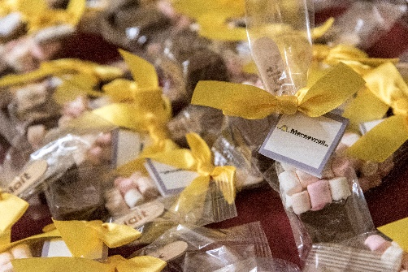
Event Management
What is event management or planning?
How do you do it?
What tools should you use to make your life easier?

Slide 3
What is event management or planning?
“the application of project management to the creation and development of events. It involves studying the brand, identifying the target audience, devising the event concept, planning the logistics, and coordinating the technical aspects before actually launching the event”

Slide 4
What is an event?
Awards, Dinners & Celebrations
Customer Experience & Engagement
Stakeholder Engagement
Co-ordination with large scale local events
Conferences, Seminars & Workshops
Fundraising such as : Golf Days, Family Fun Days, Comedy Nights, Talent Contests
School Engagement – Employability, Enterprise, Safety

Slide 5
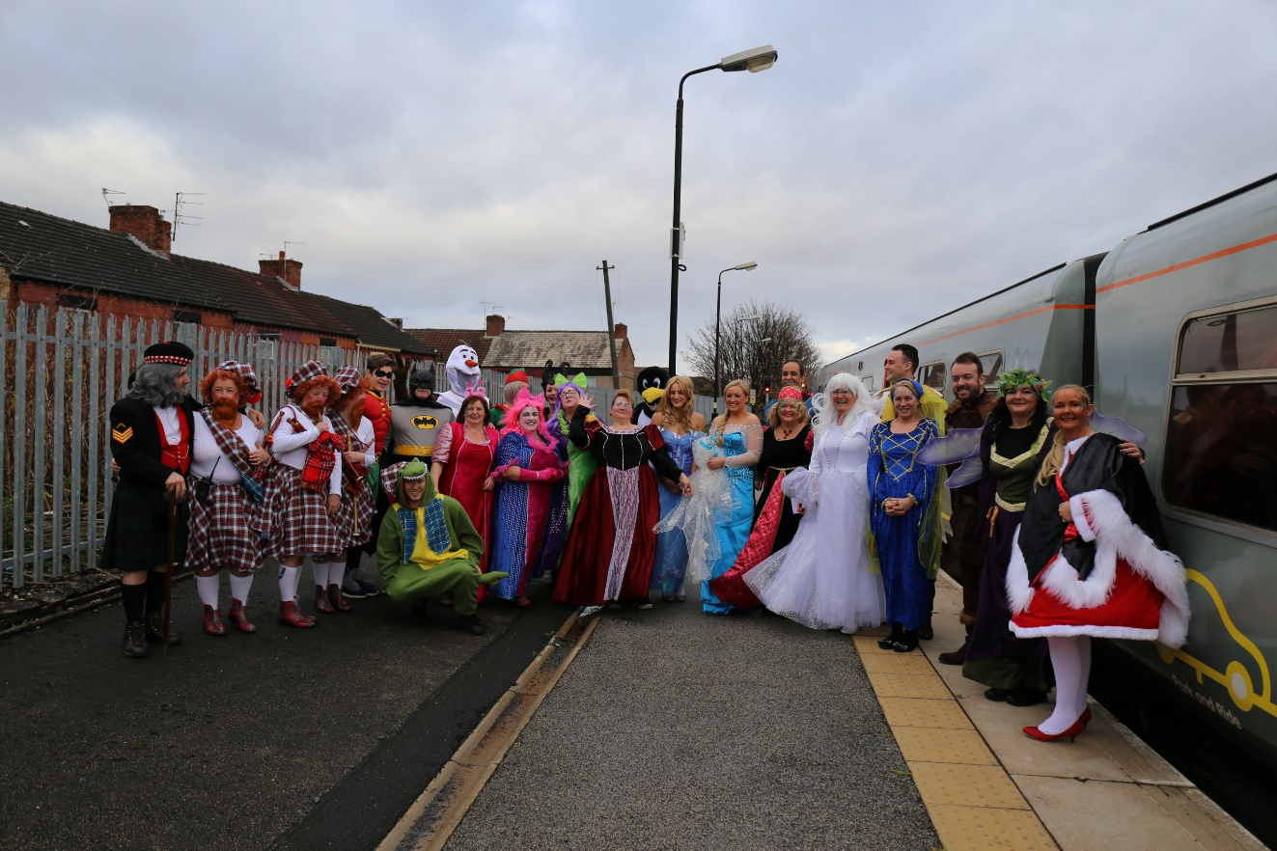
Merseyrail Events

Slide 6
How do you do it?
Creating a successful event requires a lot of hard work and a diverse range of skills and experiences from project planning to budgets
Plan, Plan & Plan
Expect the unexpected
Be flexible where possible!

Slide 7
What tools should you use to make your life easier?
Understand the objectives
Establish your timeline
Agree and manage your budget
Selecting a venue
Source & manage suppliers
Publicise your event…get your audience!
Managing risk & sustainability

Slide 8
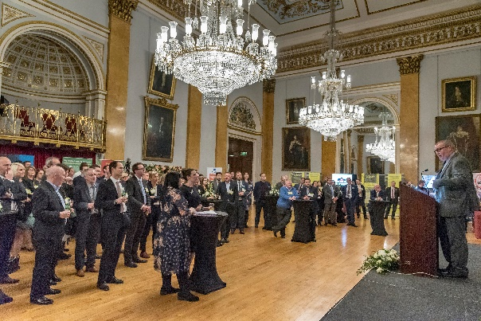
Understanding the Objectives
What is the purpose of the event?
What experience do we want people to have?
Planning an event is impossible without clear objectives.

Slide 9
Establishing Timelines
Determining what has to happen and when.
Time management
Scheduling
Co-ordination of other people’s activity – such as catering, digital and technological set up and venue preparation.

Slide 10
Managing Budgets
Second only to having clear objectives comes effective budget management.
Delivering a great event is easy with unlimited funds, but great management is required to produce an event within a constrained budget.

Slide 11

Selecting a Venue
Selecting a venue may seem simple but the importance of finding the right venue should not be underestimated.
This involves:
  research, contract and cost negotiation and building working relationships.

Slide 12
Sourcing & Managing Suppliers
Every event involves a range of suppliers. From caterers to lighting, diverse suppliers need contacting, short-listing, negotiating costs with and finalising contracts.
From there, efficient management of all suppliers, ensuring they fulfil their roles on time and within budget, is essential to the success of the event.
Strong relationships, good communications and trusted !

Slide 13
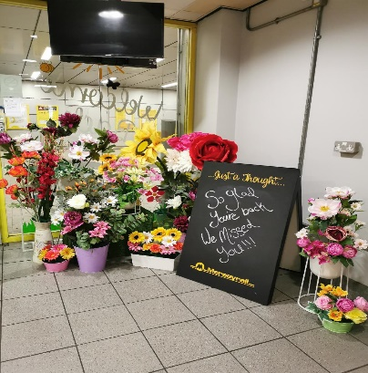
Marketing, PR & Communication
It’s never a case of if you build it they will come:
Delivering an audience requires marketing the promise of what the event will deliver!
Today this involves various channels across direct mail, social media and digital marketing.
Notes:
Eye catching invitations
Clear objective

Slide 14
Managing Risk & Thinking Sustainably
Events can be complex, as having many elements contributing to an event means multiple possible points of failure.
Understanding what the risks are
The likelihood of each one arising
Strategies to minimise risk
Develop a robust contingency plan
Making decisions in the event planning process that consider the social and environmental impact.
Notes:
Risk Assessments
Method Statements if necessary
Covid protocols
Fire Safety Regs
Local Authority requirements
Table Tops – Command Structure for large scale events such as aintree

Slide 15
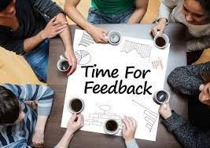
And when it is over?
Evaluate
Lessons Learnt
Feedback
Thank Everyone!
Notes:
Essential to keep building on the relationships you have made
Feedback to the suppliers and venue

Slide 16
Developing Your Skills
Organisation.
Creativity
Planning and rehearsal
Multitasking
Budgeting
Team player
People skills
An eye for detail

Slide 17
Remember….
…that event planning also takes a certain level of flexibility. Things don’t always go perfectly and that’s OK!
….and as an event planner you will learn how to think on your feet and adapt to changing situations
…and more importantly most of the time events are about enjoying yourself so when you can have fun!

Slide 18
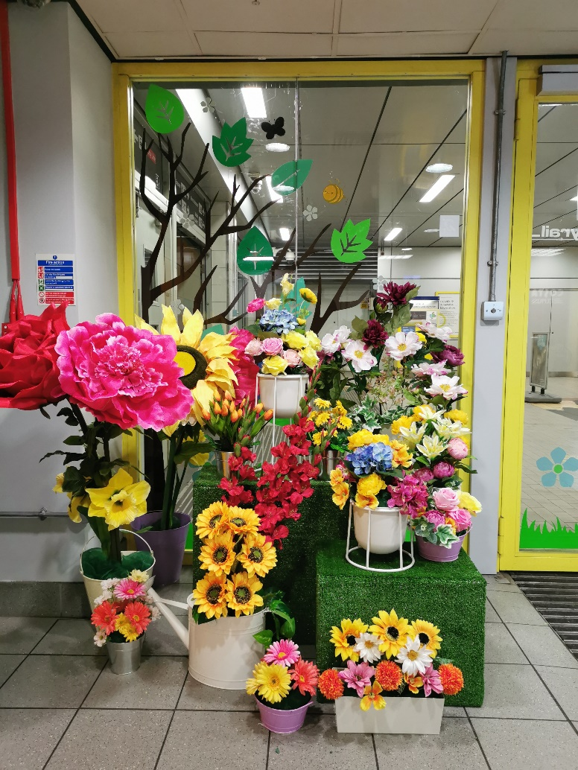
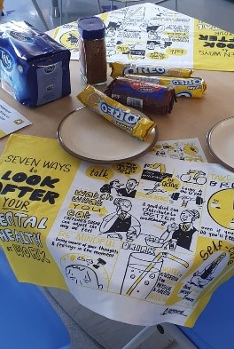
Any Questions?
“Working together to deliver a world class railway to our local region”
Notes:
Sal

